Slide 1
CSE7101- Capstone Project
Review-4
Development of AI, ML and Chat Bot powered robot mascot(Chacha Chaudhary) and 3D digital avatar to strengthen the river people connect component of Namami Gange
Batch Number : IST_16
Roll Number | Student Name
20221IST0068 | Ananya R
20221IST0101 | Harshavardhan Kurtkoti
Name of the Program: Information Science and Technology
Name of the HoD: Dr. Pallavi R
Name of the Program Project Coordinator: Ms. Benitha Christinal J
Name of the School Project Coordinators: Dr. Sampath A K , Dr. Geetha A
Under the Supervision of,
Dr.Sampath A K
Professor
School of Computer Science and Engineering
Presidency University

Slide 2
Problem Statement Number: 07
Mascot Initiative: Chacha Chaudhary was declared the mascot of the Namami Gange Programme at the 37th Executive Committee meeting of NMCG.
Current Efforts: NMCG in collaboration with Diamond Toons has developed comics, e-comics, and animated videos to spread awareness.
Challenge: These initiatives are largely one-way communication and lack real-time, interactive engagement with the audience.
Need: A more dynamic, interactive, and citizen-centric solution is required to:
Connect with school children, common people, and stakeholders.
Enhance awareness of river conservation and ecology.
Bring about behavioral change in society.

Slide 3
Objectives :
Develop an AI, ML & Chatbot-powered Robot Mascot (Chacha Chaudhary) to act as an interactive ambassador for Namami Gange.
Create a Digital Avatar on the NMCG website for wider reach and accessibility.
Enhance Public Engagement by making awareness campaigns interactive, fun, and relatable for all age groups.
Support NMCG Stakeholders with a user-friendly, citizen-centric medium for information dissemination.
Promote Behavioral Change through storytelling, gamification, and interactive experiences.
Educate School Children & Citizens about river conservation and riverine ecology in an engaging way.

Slide 4
Background and Related work for title Selection
Importance :
Lifeline: 400+ million people
Cultural & ecological significance
Pollution control & public health
Biodiversity conservation
Sanitation & waste management
Economic development
Integrated river management
Milestones Reached :
200+ STPs commissioned
Water quality improved
Million+ trees planted
UN global recognition
Community awareness programs
Infrastructure: crematoria, ghats
Real-time monitoring
ODF status achieved

Slide 5
Background and Related work for title Selection
Milestones Yet to Reach:
River-wide water quality standards
Completion of wastewater projects
Industrial effluent control
Advanced pollution tech adoption
Community behavior change
Full ecosystem restoration

Slide 6
Analysis of Problem Statement
Technology Stack Components:
AI / ML & Chatbot :
Rasa (Python) for chatbot engine
Hugging Face + scikit-learn for NLP
Speech Interaction
STT: Google Speech API / Vosk / AWS Transcribe
TTS: Google TTS / Amazon Polly / pyttsx3
Avatar & Animation
React.js + Three.js for web avatar
Frontend
React.js / Next.js for website UI
UI frameworks: Material-UI, Tailwind CSS, Bootstrap

Slide 7
Analysis of Problem Statement
Backend & Database :
FastAPI / Flask (Python backend)
Databases: PostgreSQL (structured), MongoDB (chat logs)
Cloud & DevOps
AWS (EC2, S3, Lambda, Docker)
CI/CD: GitHub Actions (preferred)
Monitoring & Analytics
Grafana (system monitoring)
Google Analytics / Power BI / Tableau (dashboards)

Slide 8
Analysis of Problem Statement (contd...)
Software Requirements:
Operating System: Windows 10/11, Android OS
AI/ML Libraries: Rasa, spaCy, HuggingFace, scikit-learn, TensorFlow, PyTorch
Speech: STT → Vosk/Google/AWS | TTS → pyttsx3/Polly/Google TTS
Avatar & Animation: Unity 3D, React.js + Three.js, Audio2Face
Backend: FastAPI / Flask / Django | DB: PostgreSQL / MongoDB
Frontend: React.js / Next.js with Material-UI / Tailwind CSS
Cloud & DevOps: AWS (preferred), Docker, GitHub Actions, Grafana
Security: SSL/TLS, JWT/OAuth2, Cloud IAM

Slide 9
Timeline of the Project (Gantt Chart)
Phases / Timeline | Review 1 | Review 2 | Review 3 | Review 4 | Review 5
Project Planning & Requirement Finalization | 20-08-2025
AI & ML Prototype Completion |  | 10-09-2025
Chatbot Integration |  |  | 23-09-2025
Digital Avatar (Chacha Chaudhary) Launch |  |  |  | 28-10-2025
Final Deployment & Community Engagement Report |  |  |  |  | 17-11-2025

Slide 10
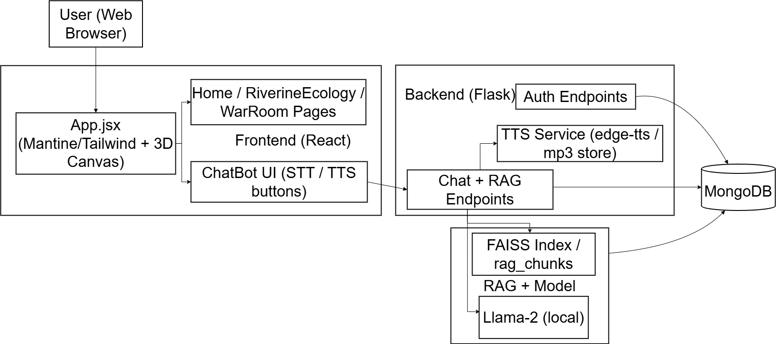
Architecture

Slide 11
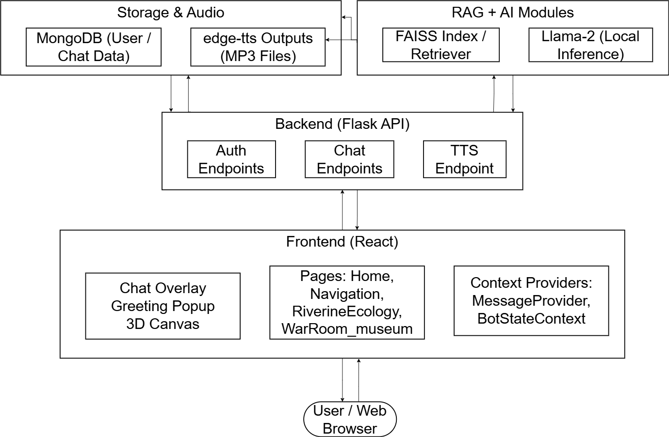
Frontend

Slide 12
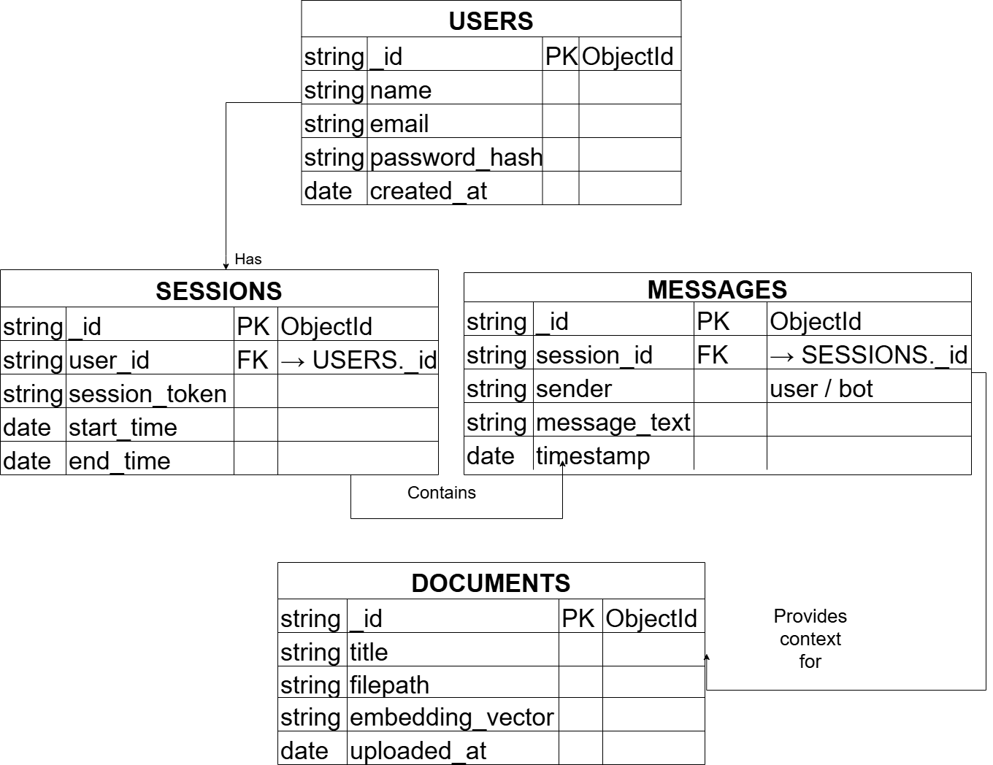
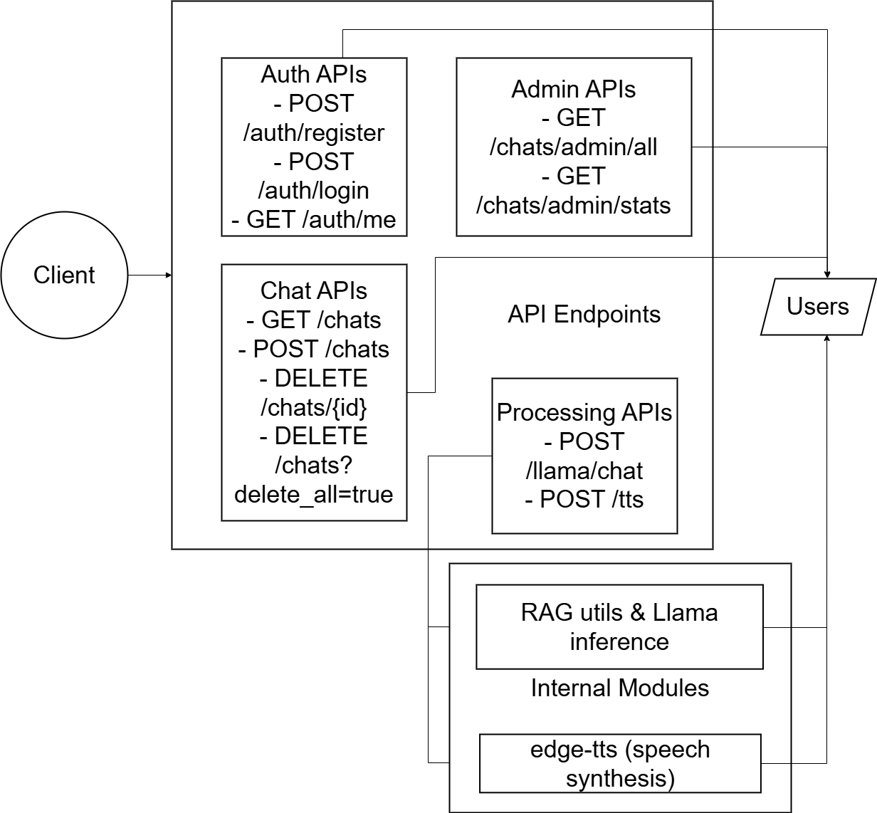
data-model
endpoints

Slide 13
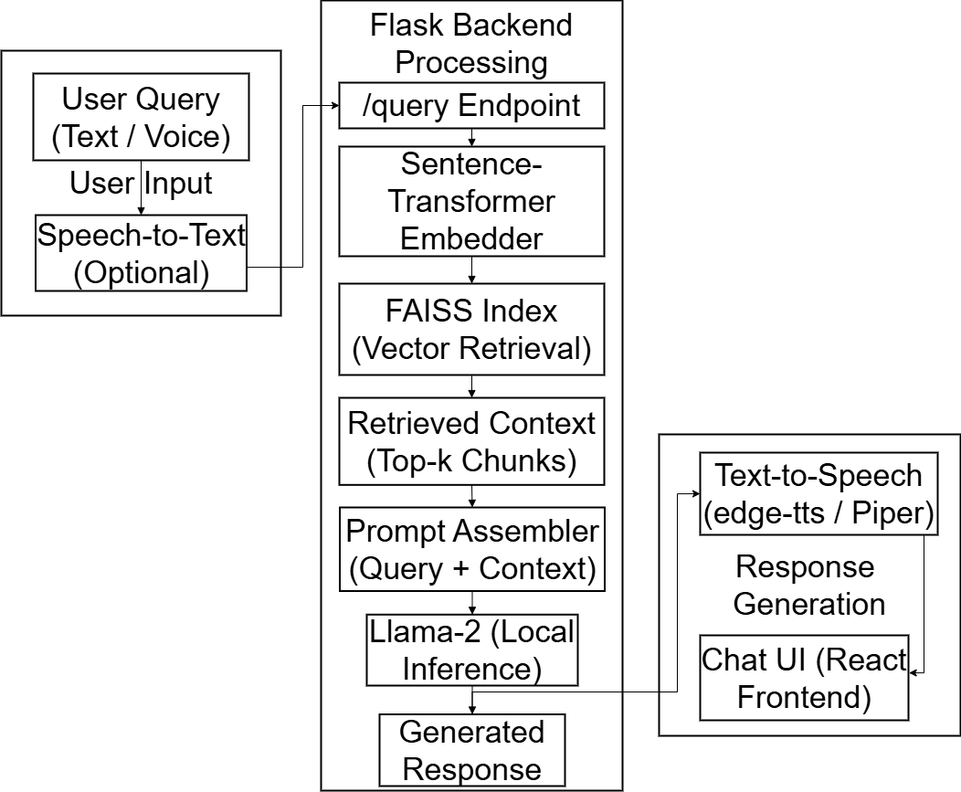
chat-flow

Slide 14
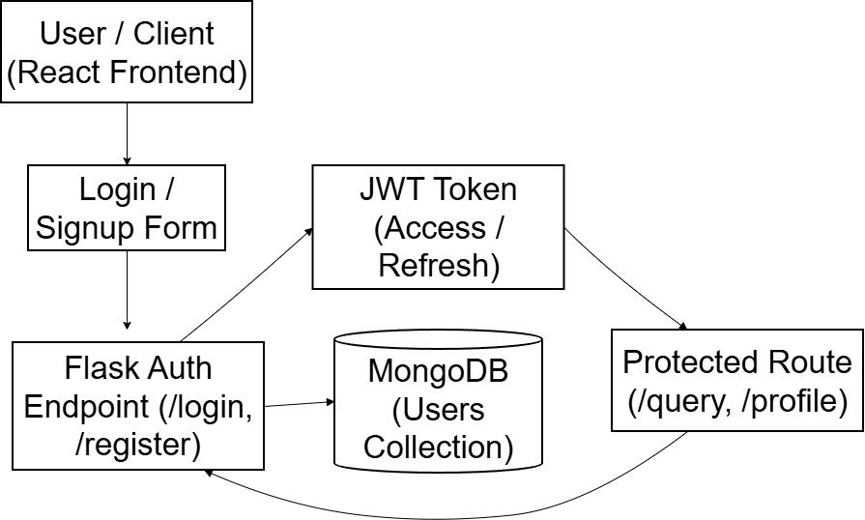
auth-flow

Slide 15
References (IEEE Paper format)
REFERENCES
[1] P. Lewis et al., “Retrieval-Augmented Generation for Knowledge-Intensive NLP Tasks,” arXiv:2005.11401, 2020.
[2] S. Liu, “Privacy-Preserving LLM Deployment on Edge Devices,” ACM EdgeAI, 2022.
[3] A. Smith and J. Clark, “Conversational Agents in Museums: Enhancing Visitor Engagement,” J. Human-Computer Interaction, vol. 36, no. 4, 2021.
[4] Hugging Face Transformers. [Online]. Available: https://huggingface.co/transformers
[5] FAISS Documentation. [Online]. Available: https://faiss.ai
[6] Flask Documentation. [Online]. Available: https://flask.palletsprojects.com
[7] React Documentation. [Online]. Available: https://react.dev
[8] MongoDB Documentation. [Online]. Available: https://www.mongodb.com/docs/
[9] Microsoft, “Edge TTS,” 2023. [Online]. Available: https://github.com/rany2/edge-tts
[10] Sentence-Transformers. [Online]. Available: https://www.sbert.net

Slide 16
Github Link
https://github.com/HarshavardhanKurtkoti/ChaCha-Chaudari

Slide 17


